Slide 1


Slide 2

Event Management System
(EMS)

Slide 3
BSCS (2013-2017)
Department Of Computer Sciences & Information Technology
Internal Viva | Date: 28th July, 2017
Event Management System (EMS) | Supervised By: Mrs. Umm-e-Habiba
Team Member | Gmail Account
Talha shahbaz | talhashahbaz27@gmail.com
Aqib Manzoor | Hafeez1ahmad786@gmail.com
Shahzad Zulfiqar | mirzaowais001@gmail.com

Slide 4
Agenda
Introduction to EMS
Static Structure of EMS
Database Diagram
Use Case Diagram
Use Case Description
Scenarios with sequence diagram
Activity Diagrams
References

Slide 5
Brief Description of EMS
A system that users will use to booking events , services online.
The event managers or service providers will be able to update the register members or users their available offer by sms alert.
User will be able to compare the available rates for a product, service or event.
Booking Event.
View his events.
Send sms to the admin.

Slide 6
What Problems will it solve?
The EMS will enable users to find out the available offers for the events that will be provided.
The user will be able to find the providers and contact them for services or events.
The user will be able to book the different events with service that should be provided.
Time saving and efficient way for event booking.

Slide 7
Class Diagram
There are two kinds of model of structure
1. Class Diagram
2.Object Diagram
We have used class model for defining static structure of EMS.
Object model can be derived from the class model as per our requirements so its omitted.
Class Diagram for EMS is given

Slide 8
Fig # 1 Class Diagram

Slide 9
Person
Id | firstName | lastName | email | password
Admin
Pid Reference Person
Customer
Id | Pid Reference Person | Address | phoneNo
Fig # 2.1 Mapping between person, admin and customer Classes

Slide 10
event
id | eventType | occupantNo |  | Date | Time | Eventstatus | customerId Reference Customer
packageId Reference Event Package
Event Package
Id | packageName | Detail | price
customer
Id | pid Reference Person | Address | phoneNo
Fig # 2.2 Mapping between customer, event and event package

Slide 11
Service
id | serviceName | detail | type
Event Gallery
id | name | photo
Latest offer
id | name | detail
Fig # 2.3 Mapping of service, event gallery and latest offer

Slide 12
Fig#3 Use case Diagram
Event management systemKotli
)
(
Log In
Log Out
Add Record
Search Record
Administrator
Update Record
User
Delete Record
book events
View Expired
events
signup
Add News
&
Alerts
Verify booking
message
Renew evnts
approve user

Slide 13
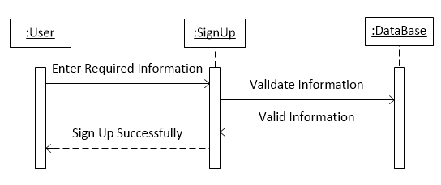
Sequence diagram with scenario for SinUp
Fig# 4.1 Sequence diagram for SinUp

Slide 14
Sequence diagram with scenario for Add services
Fig # 4.2 Sequence Diagram for Delete Records

Slide 15
Sequence diagram with scenario for Registration
The user will Provide his personal details on Registration form,
The system will validate the data and forward to database
The database will again validate the data if data validates the user will get registered
:
User
:
System
:
Database
Enter userDetail
Validate Details
User Registered
Details Validated
Fig# 4.3 Sequence Diagram for Registration

Slide 16
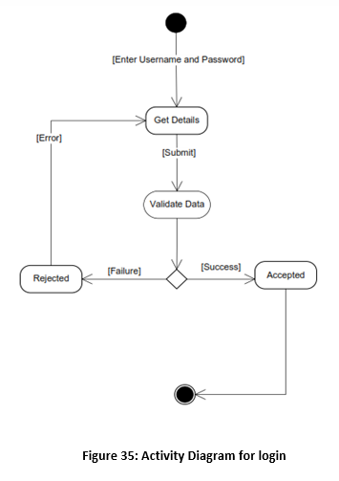
Activity diagram for Login
Figure 5.1: Activity Diagram for login into system

Slide 17
Activity diagram for logout
Figure 5.2: Activity Diagram for logout

Slide 18
Activity diagram for event gallery
Figure 5.3: Activity Diagram for Event Gallery

Slide 19
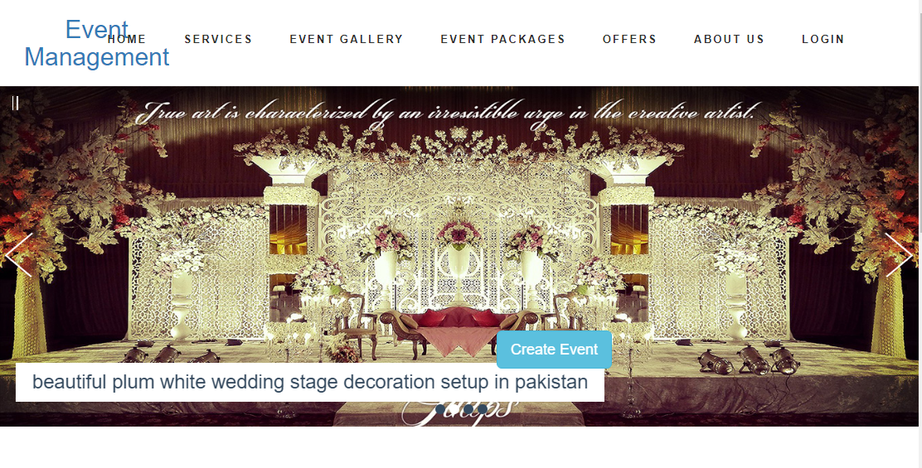
EMS Home Page

Slide 20
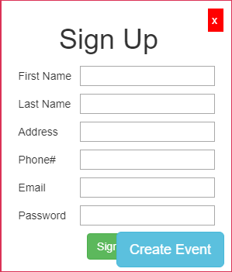
EMS SingnUp Page

Slide 21
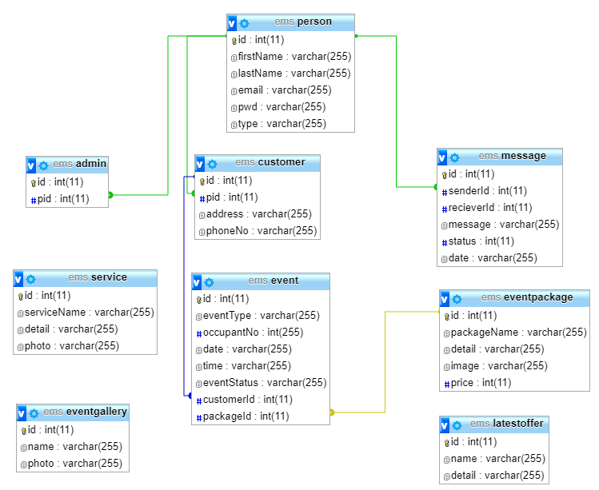
EMS Data Base

Slide 22
Development Tools
Database Tool : MySQL Version 5.5.8
Development Tool: Sublime Text3
Server : Xamp Server 2.1
Programming Language : Php 5.3.5 , Java Script,bootstrap

Slide 23
Conclusion
During this project we have learnt a lot of things.
Got much experience with Php, Javascript, html & Css
Using this application lot of advantage:
1. Time Saving
2. Efficient

Slide 24


By Michaeel Blaha & James Rumbaugh By Ian Sommerville

